Slide 1

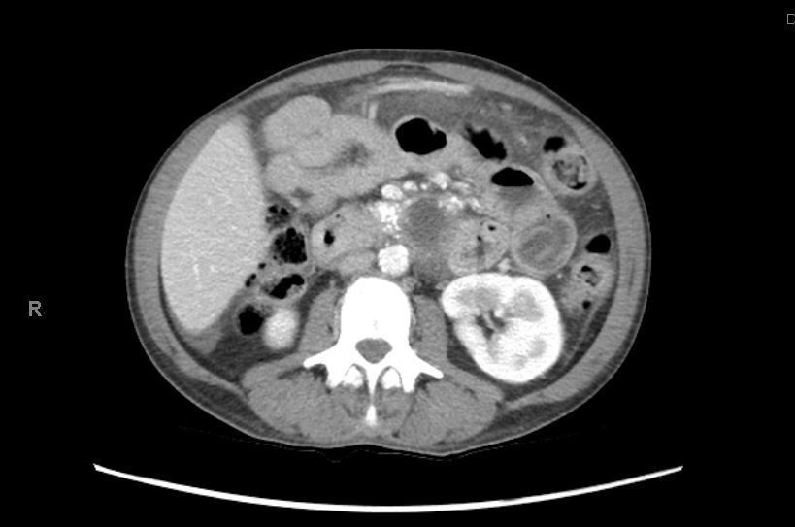
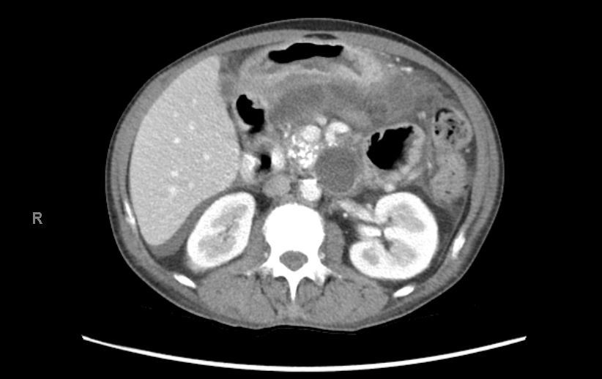
Pancreaticopleural Fistula: An Uncommon Complication of Chronic Pancreatitis
Gina Moon MD, Ahmad Basil Nasir MD, Muhammad Taha Khan MD, Tokunbo Ajayi MD, Amir Rumman MD
Department of Medicine & Section of Digestive Diseases and Nutrition
University of Oklahoma Health Sciences Center
INTRODUCTION
CASE REPORT
Pancreaticopleural fistulas (PPFs) are usually seen in middle-aged men with chronic alcoholism, occurring in 0.4% of cases of pancreatitis
Occurs when pancreatic secretions “digest” fascial planes via a pseudocyst which communicates with the pleural cavity or via a tract between the posterior pancreatic duct and the pleura
Only PPFs will demonstrate pleural fluid amylase levels >50,000U/L
This case is unique as the patient’s presentation was atypical for PPFs
Thoracic surgery declined surgery
GI offered ERP however patient declined the procedure
Patient discharged home in a stable condition with close GI follow-up
DISCUSSION
Figure 1: CT abdomen/pelvis with contrast demonstrating large pseudocyst extending from body of pancreas to the lower chest
MRCP was the most sensitive diagnostic modality for detecting PPF (80%), then ERCP (78%) and then CT (47%)
As with chronic pancreatic sequelae, PPF patients can be managed conservatively, endoscopically, or surgically, should be modified based on each patient’s pancreatic ductal defect
Presentation was atypical for PPF as patients present more commonly with pulmonary rather than abdominal symptoms
So it is imperative to keep a high index of suspicion for the possibility of a PPF
Large-scale studies examining PPF intervention success rates would be beneficial
CASE REPORT
43-year-old female with chronic pancreatitis, alcohol abuse, and tobacco abuse presents for SOB, recurrent abdominal pain and 30 lb weight loss in the past year
Was discharged a week prior to presentation after a month-long admission for acute on chronic pancreatitis
CT abdomen/pelvis with contrast showed small volume ascites, bilateral pleural effusions (greatest on left), coarse calcifications throughout the pancreatic parenchyma, a lobulated fluid collection in pancreatic body which extended superiorly into the left hemithorax around the distal esophagus through the esophageal hiatus with largest component measuring 2.3 x 4.4cm, in close proximity to the pancreatic duct (Figures 1, 2)
Labs were significant for serum procalcitonin 0.04ng/mL, lipase 104U/L, hematocrit 27.7%, CRP 45.1mg/L
Based on the Atlanta Classification, the fluid collection in the pancreatic body was concerning for a pseudocyst with developing PPFs
REFERENCES
Ali T, Srinivasan N, Le V, Chimpiri AR, Tierney WM. Pancreaticopleural fistula. Pancreas. 2009 Jan;38(1):e26-31. doi: 10.1097/MPA.0b013e3181870ad5. PMID: 19106743
Figure 2: CT abdomen/pelvis with contrast demonstrating large pseudocyst extending from body of pancreas to the lower chest

