Slide 1

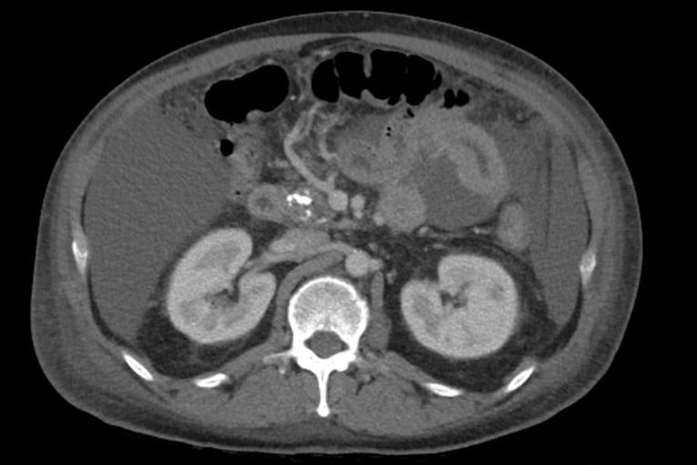
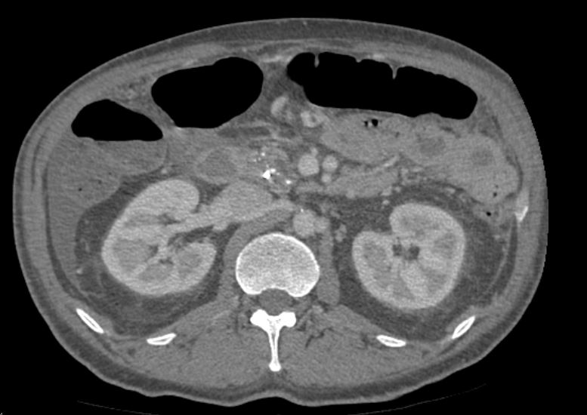
Hemorrhagic Pancreatic Ascites Treated with Pancreatic Duct Stenting
Gina Moon MD, Jalal Gondal BA, Omar Amayem DO, Tokunbo Ajayi MD, William Tierney MD
Department of Medicine & Section of Digestive Diseases and Nutrition
University of Oklahoma Health Sciences Center
INTRODUCTION
CASE REPORT
Rare causes of ascites include pancreatic, biliary, infectious, and others, each representing less than 1% of cases
Pancreatic ascites is secondary to continuous pancreatic secretion trickling into the peritoneum due to anterior pancreatic ductal disruption
Ascitic fluid studies will reveal total protein > 3g/dL, amylase > 1,000u/l, and SAAG < 1.1
Our patient presented with hemorrhagic ascites which was responsive to pancreatic duct stenting alone.
Repeat 1.2L paracentesis showed amylase 325U/L, total protein 3.2g/dL, >350,000/mm3 RBCs, 517 WBCs, 12% PMNs, LDH 205U/L, negative cytology and cultures
Repeat ERCP two months later with no pancreatic leak or fistula seen and removal of pancreatic stent with complete resolution of his symptoms
DISCUSSION
Patients with pancreatic ascites are managed conservatively, endoscopically, or surgically
Our patient was unique with the grossly bloody ascites which did resolve with only pancreatic duct stenting and no surgical or interventional radiology intervention to control bleeding
While rare, pancreatic ascites is an important differential to keep in mind in an alcoholic patient who presents with abdominal ascites including hemorrhagic ascites
Figure 1: CT abdomen/pelvis with contrast demonstrating large volume ascites with Hounsfield units over 20 suggesting complex fluid within the ascites
CASE REPORT
49 year-old male with history of alcohol abuse and chronic pancreatitis presents from an outside hospital with an acute flare of pancreatitis
CT abdomen/pelvis with acute and chronic pancreatitis, large volume ascites with complex ascitic fluid, and bilateral pleural effusions (Figure 1)
Paracentesis at outside facility yielded grossly ascitic fluid
Hgb 8.3 on admission, 7.6 at discharge two weeks later without blood products
Underwent 2.9L paracentesis: lipase 19.800 U/L, amylase 9,117 U/L
MRCP with cystic lesions in pancreatic tail concerning for IPMNs and no pancreatic ductal dilation
ERCP with pancreatic sphincterotomy and stent placement into the ventral pancreatic duct
Subsequent CTA abdomen/pelvis showed resolution of pleural effusions and decreased size of complex ascites (Figure 2)
REFERENCES
McHutchison JG. Differential diagnosis of ascites. Semin Liver Dis. 1997;17(3):191-202. doi: 10.1055/s-2007-1007197. PMID: 9308124.
Bhasin DK, Malhi NS, Nagi B, Singh K. Pancreatic ascites treated by endoscopic pancreatic sphincterotomy alone: a case report. Gastrointest Endosc. 2003 May;57(6):802-4. doi: 10.1067/mge.2003.221. PMID: 12739571.
Bracher GA, Manocha AP, DeBanto JR, Gates LK Jr, Slivka A, Whitcomb DC, Bleau BL, Ulrich CD 2nd, Martin SP. Endoscopic pancreatic duct stenting to treat pancreatic ascites. Gastrointest Endosc. 1999 Jun;49(6):710-5. doi: 10.1016/s0016-5107(99)70287-7. PMID: 10343214.
Figure 2: CT abdomen/pelvis angiogram with decreased size of small to moderate complex ascites

