Slide 1

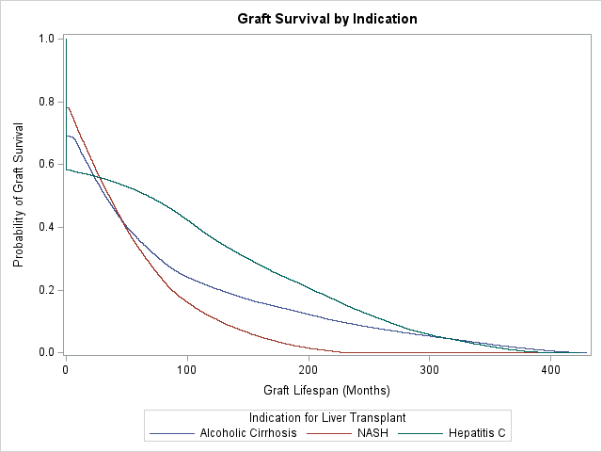
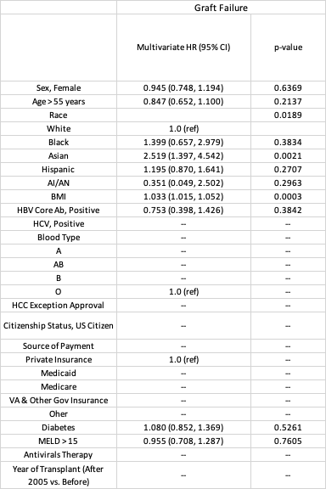
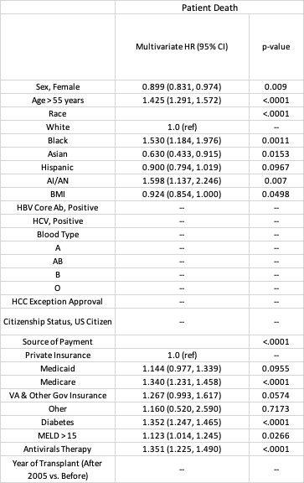
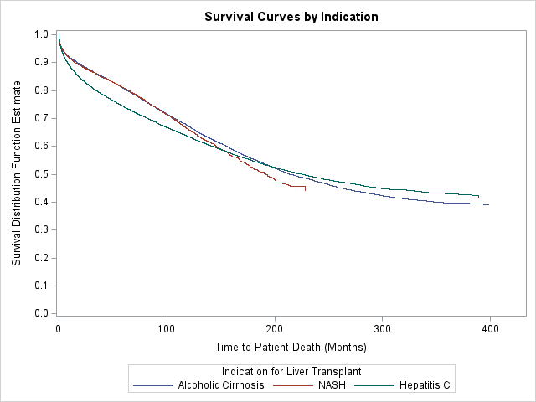
A National Database Study: NASH Liver Transplant Has Better 1-Year Post-Transplant Graft Survival in Comparison to AC and HCV Related Liver Transplants
Gina Moon MD², Tokunbo Ajayi MD^{1,2,}, Steven Pan MS³, Sixia Chen PhD³ , Abdul Oseini MD⁴ , Courtney W. Houchen MD^{1,2}
1 Section of Digestive Diseases and Nutrition, University of Oklahoma Health Sciences Center, Oklahoma City, Oklahoma, USA
2 Department of Medicine, University of Oklahoma Health Sciences Center, Oklahoma City, Oklahoma, USA
3 Hudson College of Public Health, Section of Biostatistics and Epidemiology, University of Oklahoma Health Sciences Center, Oklahoma City, Oklahoma, USA
4 Department of Transplant Surgery, Section of Transplant, University of Oklahoma Health Sciences Center, Oklahoma City, Oklahoma, USA
Introduction
Discussion
NASH is currently the second leading indication for liver transplants in the U.S. behind alcoholic cirrhosis
Aim of this study is to examine the factors that are related to graft and patient survival for the top three indications for LT recipients in the last three decades.
A study published in 2009 found that 1-year mortality was highest among NASH recipients vs. alcoholic liver disease vs. hepatitis C. We found the opposite to be true, possibly due to advancements in NASH PT care
As expected, obesity, diabetes, older age, and MELD > 15 were associated with a higher risk of patient death or graft death
There was an increase in patient death in Blacks and American Indians after NASH LT and this may be due to poor access to post LT care. More investigations need to be conducted to elucidate an etiology for this finding
Methods
We retrospectively reviewed the SRTR database for sociodemographic and clinical factors related to graft and patient survival in NASH, alcoholic cirrhosis (AC), and hepatitis C (HCV) LT recipients from 1987 - 2022 in the US
Kaplan-Meier curves and estimated probabilities for graft and patient survival were created for the three indications.
Multivariate Cox regressions were conducted with relevant predictors from the following: gender, age, ethnicity, HBV and HCV status, HCC exception criteria, blood type, US citizenship status, payment source, BMI category (< 30 vs. ≥ 30), diabetes status, MELD (< 15 vs. ≥ 15), antiviral therapy, and year of transplant (before or after 2005)
Panel A: Kaplan-Meier curve for graft survival in liver transplant recipients for alcoholic cirrhosis, NASH, and hepatitis C from 1987 - 2022
Results
35,482 recipients were transplanted for NASH from 1987-2022: average age was 59, 46% female, 80% White, 44% blood type O, 96% US Citizens, 51% privately insured, and 56% diabetics
Comparing the three LT indications, graft survival probability 1 year post-transplant (PT) was best for NASH, however 3 years PT and thereafter, HCV graft survival was superior
Patient survival rates were highest for NASH and AC up to 10 years PT. HCV LT recipients had the worst patient survival rates
Asian (HR 2.52) and BMI > 30 (HR 1.03) had a higher risk for graft failure. Interestingly, these same two demographics and females (HR 0.90) had lower risk for patient death
Age > 55 (HR 1.43), Black (HR 1.53), American Indian (HR 1.60), Medicare source of payment (HR 1.34), antiviral therapy (HR 1.35), diabetes (HR 1.35), and MELD > 15 (HR 1.12) were associated with an increased risk of NASH LT patient death
Table 1: Multivariate Cox Regression Models Examining Risk Factors for Graft Failure and Patient Death in Liver Transplant Patients with Nonalcoholic Steatohepatitis (NASH) from 1987 – 2022 (n= 14,208 for Graft Failure model, n= 12,145 for Patient Death model)
Panel B: Kaplan-Meier curve for patient survival in liver transplant recipients for alcoholic cirrhosis, NASH, and hepatitis C from 1987 - 2022

