Slide 1
MCAT

Slide 2
What is the MCAT?
Medical College Admission Test (or MCAT) is a standardized, multiple-choice, computer-based test of 230 questions comprising 4 main sections:
Biological and Biochemical Foundations of Living Systems
Chemical and Physical Foundations of Biological Systems
Psychological, Social, and Biological Foundations of Behavior
Critical Analysis and Reasoning Skill
Notes:
Fee assistance: Fee Assistance Program | Students & Residents (aamc.org)

Slide 3
Biological and Biochemical Foundations of Living Systems
  You have 95 minutes to answer 59 questions
  65% Intro to Biology, 25% First-Semester Biochemistry, 5% General Chemistry, 5% Organic Chemistry
Chemical and Physical Foundations of Biological Systems
  You have 95 minutes to answer 59 questions
  30% General Chemistry, 25% First-Semester Biochemistry, 25% Intro to Physics, 15% Organic Chemistry, 5% Intro to Biology
Psychological, Social, and Biological foundations of behavior
  You have 95 minutes to answer 59 questions
  65% Intro to Psychology, 30% Intro to Sociology, 5% Intro to Biology
Critical analysis and reasoning skill
  You have 90 minutes to answer 53 questions
  50% Humanities, 50% Social Studies
Notes:
Science Related Questions (roughly):
44 questions are Biology Related
38 questions are Psychology Related
30 questions are Biochemistry Chemistry Related
21 questions are General Chemistry Related
18 questions are Sociology Related
15 questions are Physics Related
12 questions are Organic Chemistry Related

Slide 4
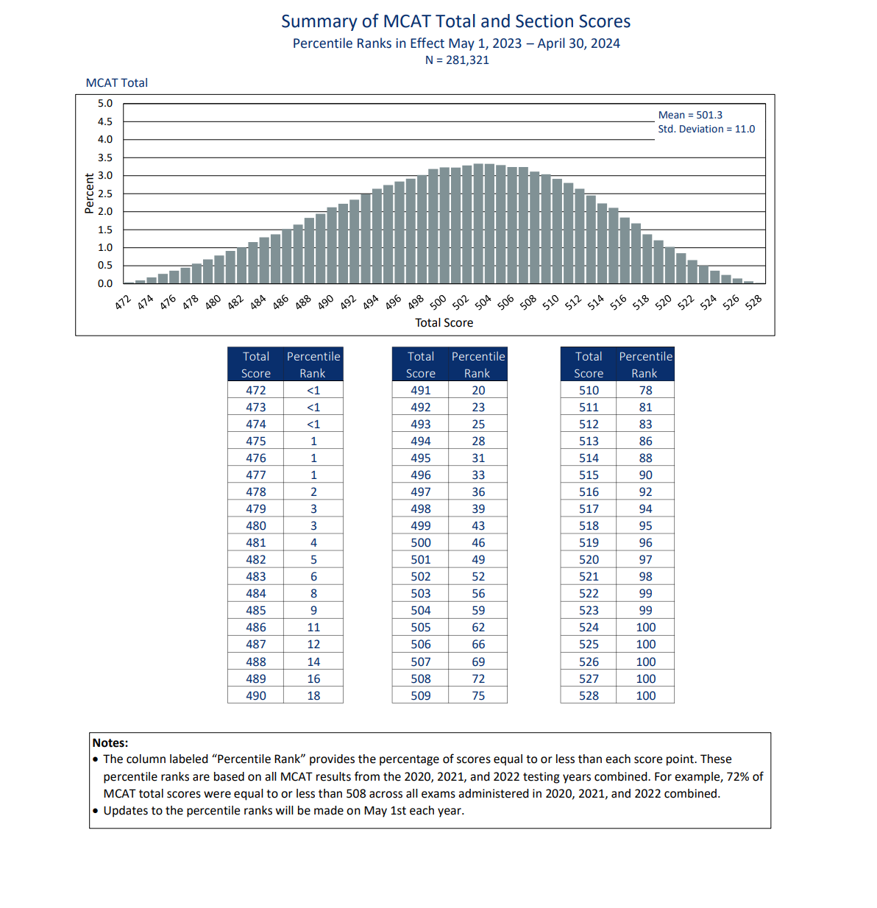
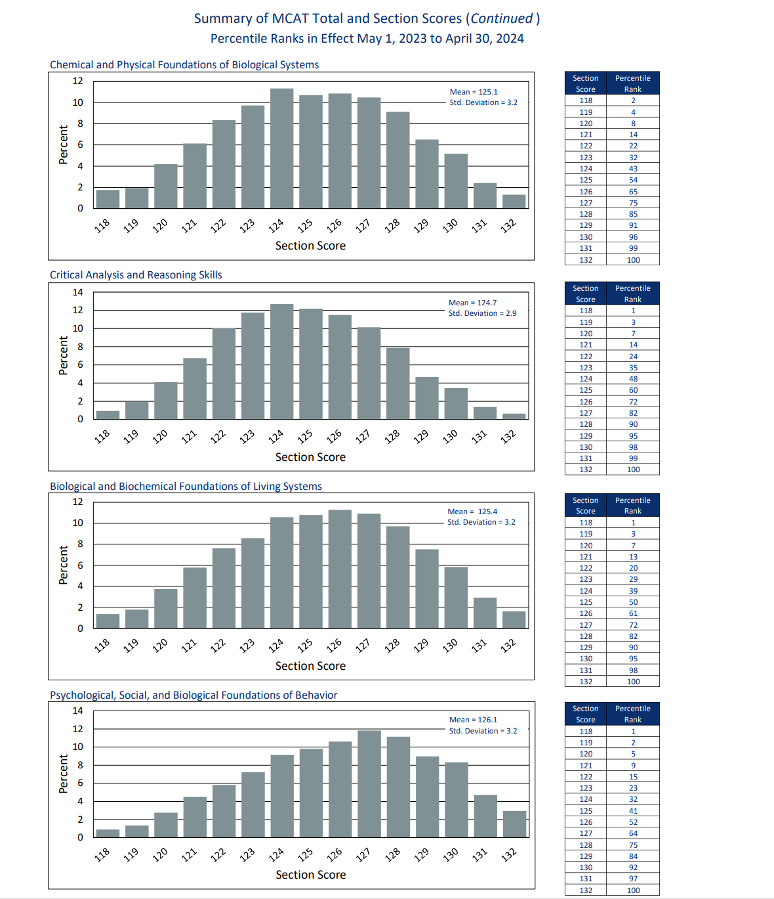
MCAT Summary
Notes:
MCAT total and section score percentile ranks_2023_for Web.xlsx (aamc.org)

Slide 5
So, Do I have to major in science to go to medical school?
Medical School acceptance rate by major
Biological Sciences - 43%
Humanities - 52%
Math and Statistics - 52%
Other - 42%
Physical Sciences - 50%
Social Sciences - 43%
Specialized Health Sciences - 40%
Notes:
What Are the Best Pre-Med Majors? | Key Info + Stats (inspiraadvantage.com)

Slide 6
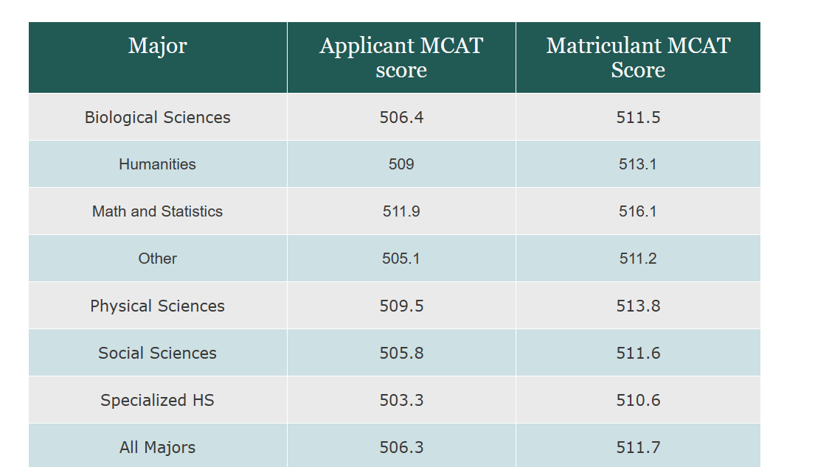
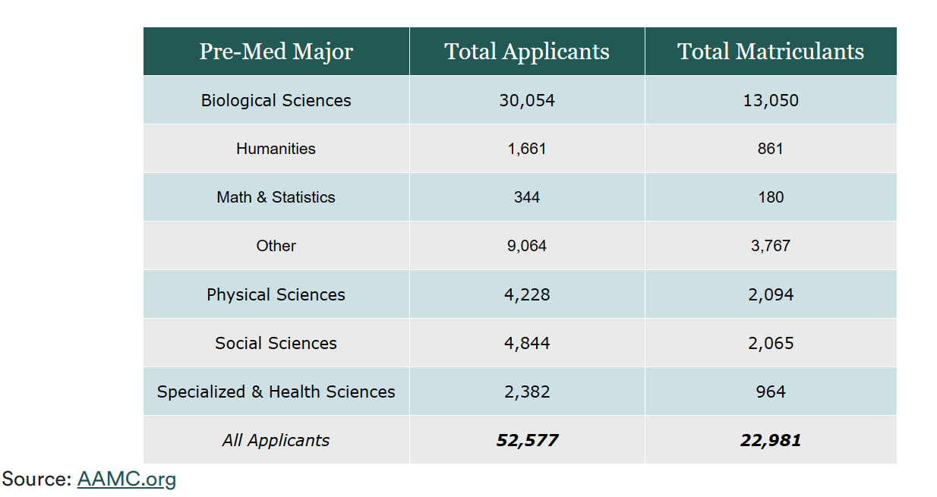

Slide 7
Preparing for the MCAT
There is NO one right way to study for the MCAT
More is not always better when it comes to resources
Be intentional with your study schedule (3-6 months? 200-400 hours?)
Take practice tests/questions to better gauge how ready you are (also, don’t get discouraged by these)
TAKE BREAKS FROM STUDYING
Notes:
How I Prepared for the MCAT® Exam | Students & Residents (aamc.org)

Slide 8
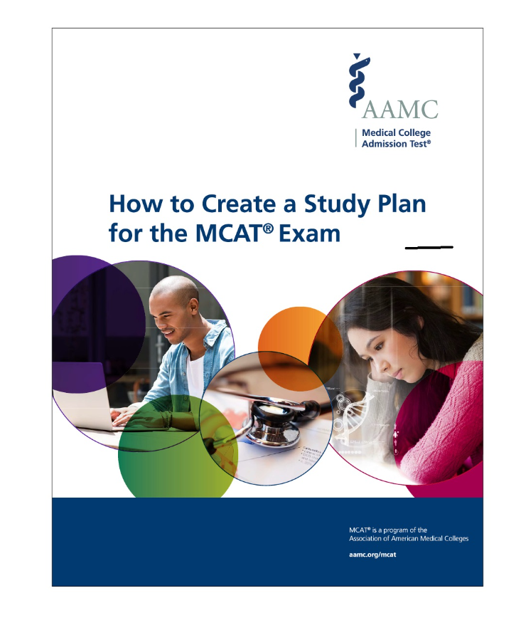
There are Many ways to study
set aside time AND Build a schedule
Before you’re ready to start studying for the exam, spend some time organizing a schedule.
Make sure your schedule has breaks!
Do practice tests and practice questions but make sure you set time aside to review both.
Notes:
How to Create a Study Plan for the MCAT® Exam | Students & Residents (aamc.org) – Free download
MCAT Prep Options | Blueprint Prep (formerly Next Step) – Paid calendar and classes

Slide 9
Resources
The ultimate MCAT FREE resource Compilation
AAMC content
Jack westin
ANKI
Khan Academy
UWORLD
Notes:
The Ultimate MCAT Free Resource Compilation (notion.site) – Arvind Rajan
AAMC MCAT Official Prep Online-Only Bundle
Jack Westin | The Home for MCAT Preparation and Courses
MCAT | Test prep | Khan Academy
AnkiWeb
MCAT® Test Prep and Practice Questions - UWorld MCAT Qbank

Slide 10

Anki
Digital learning tool that utilizes spaced repetition to optimize memory retention and recall
Open source “Flashcards” with a community that collaborates and refines study content
Free download to computer with collaborative decks
Can make your own decks
MILEDOWN deck for MCAT studying
Notes:
Anki - powerful, intelligent flashcards (ankiweb.net)

Slide 11
Financial Resources
AAMC FEE ASSISSTANCE PROGRAM
MED SCHOOL COACH SCHOLARSHIP
Assistance program for families that a burdened by the growing costs of MCAT and medical school applications.
Advisement on medical school application, MCAT prep, etc. Has free resources and offers yearly scholarships.
ElevateMeD
M3 Scholarship Mim Scrubs
ElevateMeD recognizes the multifaceted shortcomings in the pipeline toward a career in medicine. Our focus is creating financial assistance for bright and talented medical students from historically underrepresented backgrounds.
The M3 Scholarship was designed to alleviate the financial burdens associated with the application process while encouraging minority pre-medical students to continue striving towards a career in medicine
Notes:
Fee assistance: Fee Assistance Program | Students & Residents (aamc.org)
Who Is Eligible to Participate in the Fee Assistance Program? | Students & Residents (aamc.org)
Med school coach
How to Get Financial Aid for Advising, Tutoring, and Clinical Travel | MedSchoolCoach
ElevatedMeD:
Who We Are — ElevateMeD
M3 Scholarship:
M3 NonProfit/Scholarship - Mentoring Minorities in Medicine - M3 – Mim Scrubs - Millennials In Medicine

